Slide 1
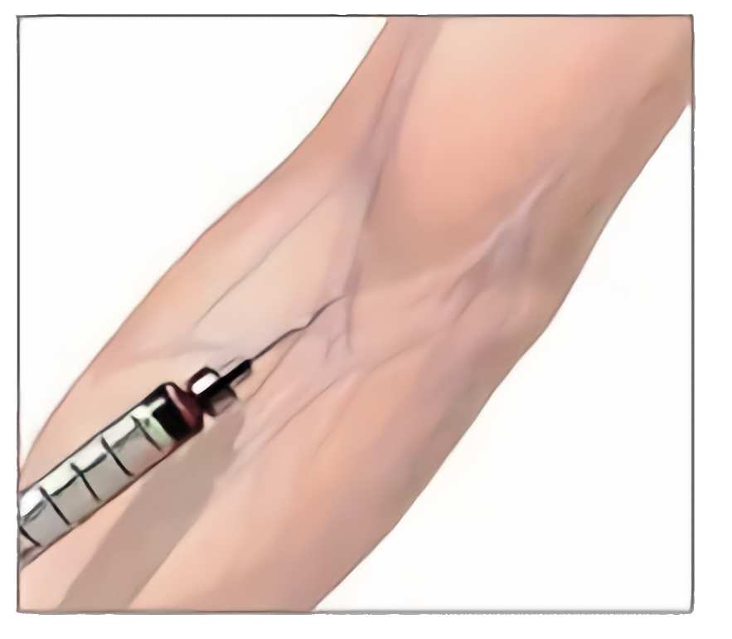
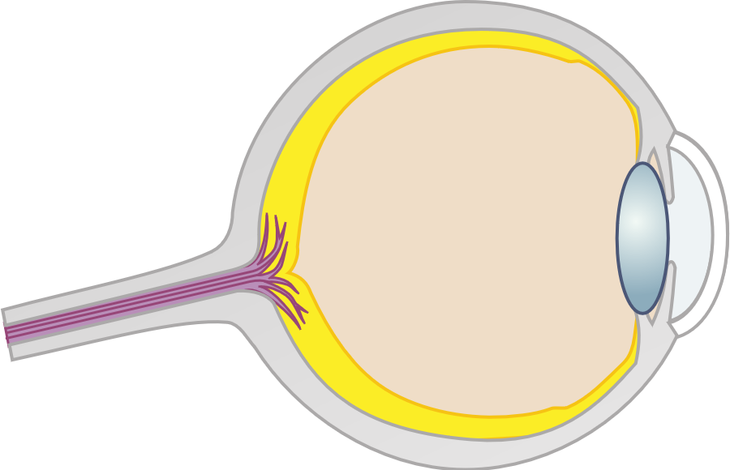

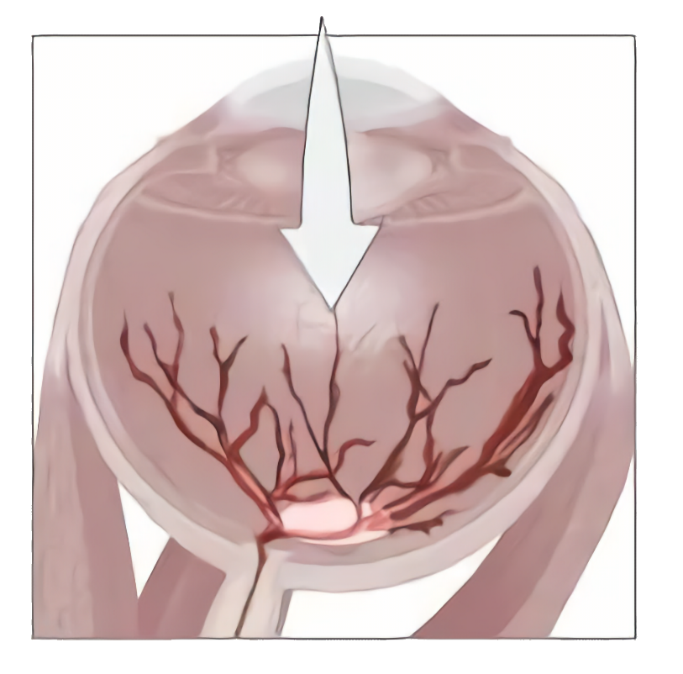
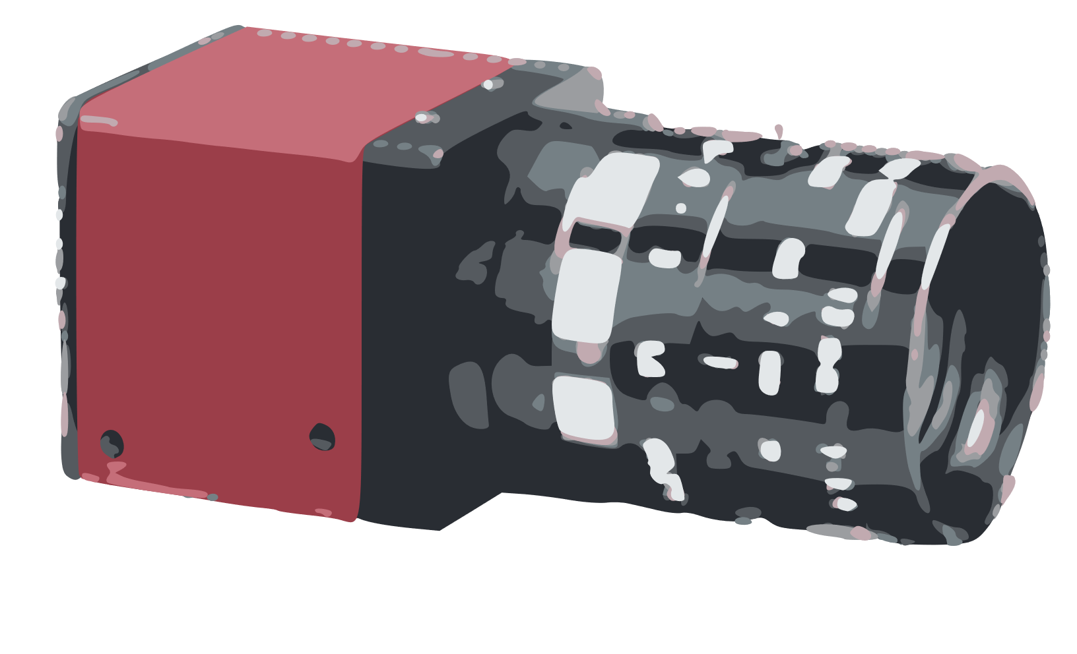
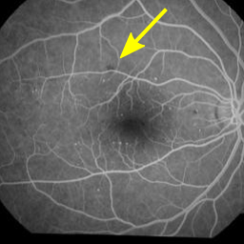
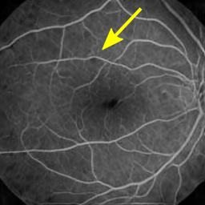
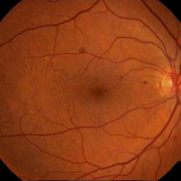
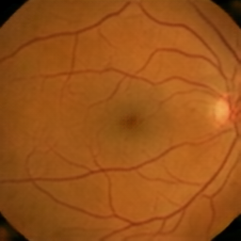
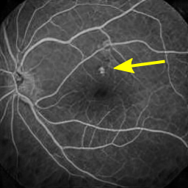
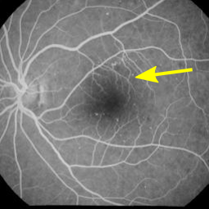
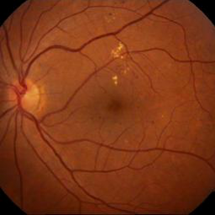
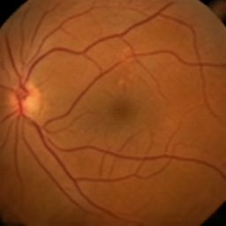
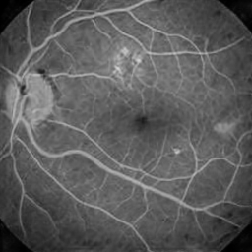
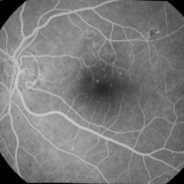
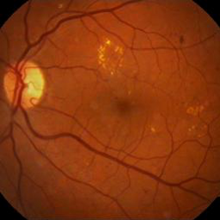
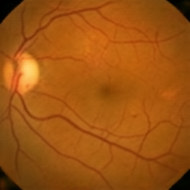
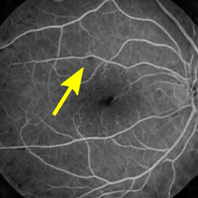
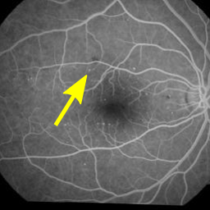
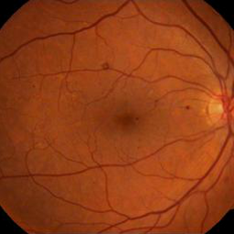
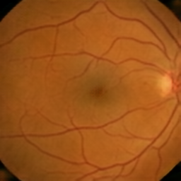
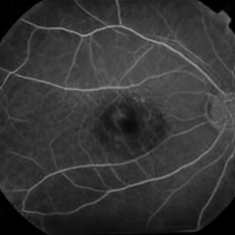
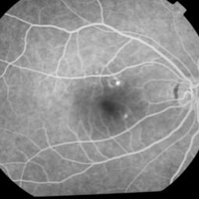
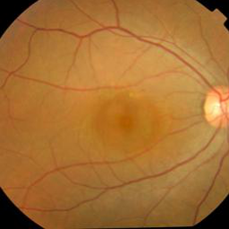
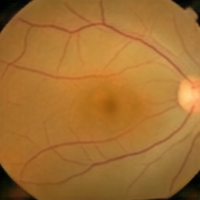
Synthetic Fundus Fluorescein Angiography using Deep Neural Networks
Florian Schiffers^{1,2}, Zekuan Yu¹, Steve Arguin¹, Andreas Maier², Qiushi Ren¹
¹ Department of Biomedical Engineering, College of Engineering, Peking University, Beijing, China ² Pattern Recognition Lab, Department of Computer Science, Friedrich-Alexander University Erlangen-Nuremberg, Erlangen, Germany
Angiographic Fundus Imaging
Special dye is injected
Excitation filter
Blue light
Light Source
Fluorescein in retinal vessels
White light
Fluorescent light
Reflected light
Barrier filter
Camera
Figure 1: Illustration of the axial Noise Power Spectrum of
(a) Conventional CT (b) Differential CT (D-CT). Noise in D-CT is concentrated in the lower frequencies. The relative scaling is dependent on the measurement setup.
Materials and Methods
Angiographic imaging may pose risks of harm to the patient
Equivalent to deconvolution with the inverse filter – allows application of noisy deconvolution techniques to CT
Utilize linear Wiener deconvolution for ease-of-use and speed
Denoising 2-D reconstruction filter W is defined in Fourier domain as:
The ratio N/S defines prior knowledge about the reconstructed object
We assume a signal-to-noise ratio of λ, quadratically decaying towards high frequencies
Results and Discussion
Computational Complexity: Negligible increase (2-D Fourier Transform vs. 1-D Fourier transform for FBP)
Substantial noise reduction possible for both CT and D-CT
Higher PSNR gain for CT compared to D-CT for optimal λ due to less spectral overlap of object and noise (+6.9dB vs +4.2dB)
Conventional CT: noise/resolution tradeoff (Fig. 2a)
Differential CT: noise/contrast tradeoff (Fig. 2b)
Planned: further experiments to investigate the effect on quantitation
Conclusions
Figure 2: Axial slices of reconstructions of the 3-D Shepp-Logan phantom from noisy projections. (a) CT reconstruction. Decreasing the parameter λ trades resolution for less noise. (b) D-CT reconstruction. Here, decreasing λ trades contrast for less noise. This can be attributed to the different Noise Power Spectra of both applications.
Noise suppressing filter for (differential) filtered backprojection
Linear method: low computational cost
Regularization independent of backprojection filter
References
[1] Raupach & Flohr: Analytical evaluation of the signal and noise propagation in x-ray differential phase-contrast computed tomography. Phys Med Biol. 2011 56(7)
Contact
 florian.schiffers@fau.de
☒ http://www5.bme-pekein ….
Pattern Recognition Lab, Department of Computer Science, Friedrich-Alexander University Erlangen-Nuremberg http://www5.cs.fau.de

